Slide 1
Notes:
Welcome to the workshop

Slide 2
Why did Jesus die?
Understanding and communicating
“the message of the cross”
Notes:
In this workshop, we are going to be thinking more about the “message of the cross,” seeking to grow our understanding of the significance of the cross.
What was the purpose of the cross? Why did Jesus die? What good did it do?
Hopefully, by growing our understanding we will also grow our ability to communicate the "message of the cross"
I'm hoping it will be quite interactive:
Have about 20 minutes of material to present, but also want to get you talking.

Slide 3
“The crucifixion does not easily explain itself and requires interpretation… What is the universal, world-transforming significance of the crucifixion? It is not self-evident.”
> Fleming Rutledge, The Crucifixion
Notes:
Want to start by getting you talking.
Think about the following quote: what do you think of it?
Do you agree or disagree? Why? Discuss in pairs for 2 minutes.
I agree that the crucifixion of Jesus requires interpretation.
Fleming Rutledge makes this statement while expositing the conversation between Jesus and the two disciples on the road to Emmaus.
“our chief priests and rulers delivered him up to be condemned to death, and crucified him.” – Luke 24:20
The knew about the crucifixion, maybe even saw it, but didn’t understand it.
Jesus needed to explain the importance of his death for them.

Slide 4
Notes:
Let me try and make the same point visually:
This is a Caravaggio. What is the subject of his painting? [the crucifixion of St Andrew]

Slide 5
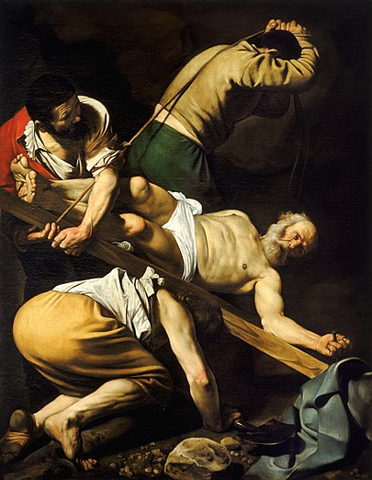
Notes:
Here’s an even better painting, shows off Caravaggio’s style to better effect.
What is the subject of this painting? [the crucifixion of St Peter – a little more obvious]
It would be quite easy to get mixed up and think these are paintings of Jesus.
Because visibly, there was no difference between the crucifixion of Jesus or Andrew or Peter, or Spartacus.
But of course we believe the cross has an invisible significance – it is the power of God for salvation.
To really understand the cross, you can’t just observe it, you have to interpret/explain it.

Slide 6
Triumph
Glory
Healing
Example
Justification
Covenant
Redemption
Immortality
Deliverance
Ransom
Passover
Propitiation
Peace
Forgiveness
Reconciliation
Sacrifice
Adoption
Notes:
Of course, a lot of explaining and interpretation has been done for us in the Bible:
Here are some of the words the Bible uses when explaining what happened on the cross.
For instance…
But of course, the Bible itself needs to be understood and explained.
and so Christian thinkers, based in the Bible, in faith, have continued to seek/deepen understanding of the cross.
Over the centuries Christian thinkers have tried to put the various images and words together and clarify their own thinking.
In this session, I want us also to think about the cross.
Christ also suffered for you, leaving you an example – 1 Peter 2:21
We have now been justified by his blood – Romans 5:9
Jesus… gave himself for our sins to deliver us from the present evil age – Galatians 1:4
The Son of Man came… to give his life as a ransom for many – Mark 10:45
In him we have redemption through his blood – Ephesians 1:7
He disarmed the rulers and authorities and put them to open shame, by triumphing over them in him – Col 2:15
Our Passover lamb – 1 Corinthians 5:7
Jesus, whom God put forward as a propitiation by his blood – Romans 3:25
While we were enemies we were reconciled to God by the death of his Son – Rom 5:10
Without the shedding of blood there is no forgiveness of sins – Hebrews 9:22
This is my blood of the covenant – Matthew 26:28
By his wounds we are healed – Isaiah 53:5
God sent forth his Son… so that we might receive adoption as sons – Galatians 4:4-5
Christ… gave himself up for us, a fragrant offering and sacrifice to God – Ephesians 5:2
Making peace by the blood of his cross – Colossians 1:20
Jesus, who abolished death and brought life and immortality to light through the gospel – 2 Timothy 1:10
The hour has come for the Son of Man to be glorified – John 12:23

Slide 7
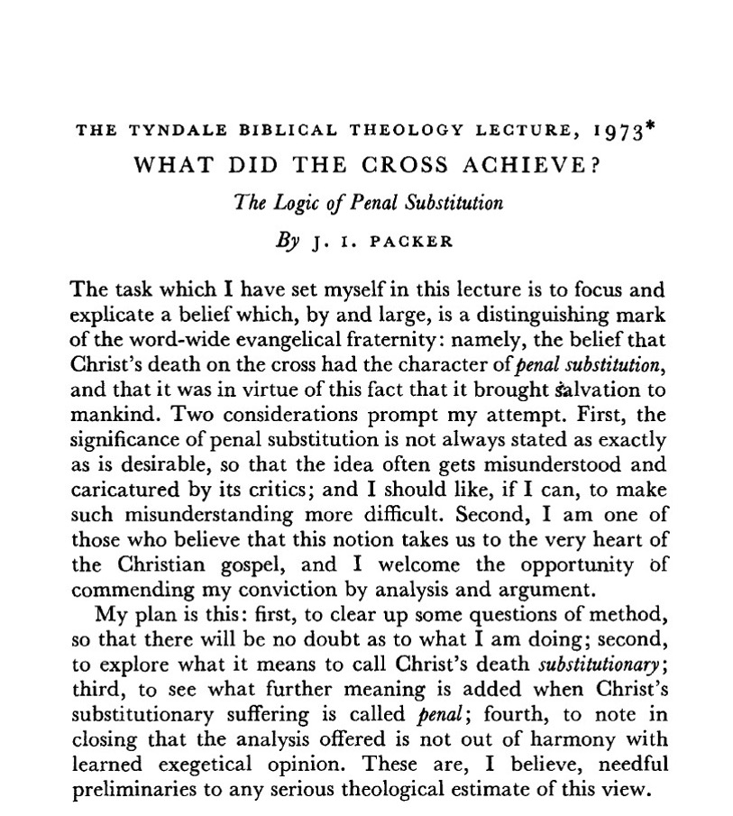
Three explanations
“The [first] type of account… sees the cross as having its effect… on men… by revealing God’s love to us.”
Notes:
To help us, I’m going to base this session in some comments from a brilliant paper by JI Packer.
He says that across Christian history, there are basically three ways that people have tried to explain the significance of the cross.
[read quote]

Slide 8
Three explanations
“A second type of account sees Christ’s death as having its effect primarily on hostile spiritual forces external to us…”
Notes:
To help us, I’m going to base this session in some comments from a brilliant paper by JI Packer.
He says that across Christian history, there are basically three ways that people have tried to explain the significance of the cross.
[read quote]

Slide 9
Three explanations
“The third type of account [maintains] Christ's death had its effect first on God, who was hereby propitiated... by dying Christ offered to God what the West has called satisfaction for sins.”
Notes:
To help us, I’m going to base this session in some comments from a brilliant paper by JI Packer.
He says that across Christian history, there are basically three ways that people have tried to explain the significance of the cross.
[read quote]

Slide 10
Compare and contrast
 | Moral Influence | Christus Victor | Satisfaction
Effect | On humanity | On spiritual powers | On God
Theological Champion | Abelard (1079-1142) | Origen (c. 185-253) | Anselm (1033-1109)
Notes:
So, in summary, Packer says that there are three basic ways that people have understood the cross:
We can classify these three ways according to whom the cross is meant to affect.
Does the cross have its main effect on people? Are people the audience?
Or on Satan and evil powers? Is the main audience for the crucifixion powers and principalities?
Or on God? Is the main audience for the crucifixion God the Father?
The common names used for these three views are ‘moral influence’, ‘Christus victor’, and ‘satisfaction’
Each of these approaches has had famous advocates in the history of the church.
To help us understand these ideas better, let’s look at three individuals in church history…

Slide 11
Origen
Jesus redeems us back from slavery to the Devil
“But to whom did [Jesus] give his soul a ransom for many? Certainly not to God. Was it perhaps, then, to the evil one? For he had power over us until the soul of Jesus was given to him as our ransom. He was deceived of course and imagined that he could have power over it.”
> Commentary on the Gospel of Matthew, vol. 1, book 16.8
Notes:
Taking them in order of appearance, let’s take Origen (c. 185-253) first:
Key idea in Origen's explanation of the cross – God redeems us back from slavery to the Devil.
Origen took his starting point as Matthew 20:28: “the Son of Man came not to be served by to serve, and to give his life as a ransom for many.”
[read quote]
Origen is quite brief, even offhand, but a couple of his concepts were developed very extensively by later writers:
First, that the ransom is paid to the Devil.
This was developed into an idea that because people of their own free will had gone over to the dark side and become “sons of disobedience”, the Devil has legitimate rights over people that need to be paid off.
The second concept was that the Devil was deceived or mistaken in thinking he could hold on to Jesus or have power over him.
Later writers developed this into a deliberate strategy of God, that he was tricking the Devil into taking the bait and making the exchange.
The image of fishing with a baited hook was common – the humanity of Jesus was like the bait, the unconquerable divinity of Jesus was the hook.
This is a specific type of Christus Victor idea – that Jesus won a victory over the Devil through a ransom to him.
But there are other ways of developing the idea that the cross is a victory.
For instance, NT Wright has developed this kind of idea extensively, based on the idea that at the most fundamental level, sin is idolatry:
'“Sin”... is not simply the breaking of God’s rules. It is the outflowing of idolatry.' - The Day the Revolution Began.
We need to be rescued from alegiance to false gods, to spiritual powers and authorities, and this is accomplished in Jesus.
The key concept is that the cross has an impact of the Devil, and is the way that a victory is won over sin, death and Satanic powers.

Slide 12
Anselm
Jesus pays the debt we owe to God for sin
“The restoration of human nature… could not have been brought about unless man repaid what he owed to God. This debt was so large that although no one but man owed it, only God was capable of repaying it… hence it was a necessity that God should take man into the unity of his person… to make the repayment.”
> Why God Became Man, 2.18
Notes:
Next let’s look at Anselm (, who lived in the middle ages:
Key idea: Jesus pays the debt that we owe to God for our sin.
In one of his books, this is what Anselm says about how humanity is saved by Jesus [read quote].
Anselm didn’t agree with the idea that the Devil has any legitimate rights over humanity, so he didn’t like the ransom idea.
He says the essence of the problem is not enslavement to Satan, but wrongdoing that offends and dishonours God.
Because humanity have not honoured God as they should, they have incurred a debt.
Because the debt is so big, only God is big enough to pay it off.
Hence he became one with us in our humanity in order to pay God off.
The way Anselm understands it, humanity needs to make a suitable gift to God to restore the relationship.
Like buying flowers for the wife.
The life of Jesus is a gift given to God in order to restore his honour, satisfy him, and reconcile us.
The reformers Calvin and Luther liked this basic idea that the cross is a payment or satisfaction offered to God, but tweaked it:
Humans had broken God’s law and therefore deserve punishment.
Death is the punishment or penalty for breaking the law.
But Jesus substituted his death for ours, and took our punishment, so that we don’t have to.
In this way the justice of God is satisfied by the death of Jesus.
Sound familiar?
Without a doubt this is the idea we hear most often in our churches, it has a special name – Penal Substitutionary Atonement.
Atonement = being made at one with God
Substitutionary = Jesus is our substitute
Penal = Jesus pays the penalty as our substitute.

Slide 13
Abelard
Jesus shows us the love of God so we will love him back
“What is this redemption of ours? … in this we are justified in the blood of Christ and reconciled to God... that his Son received our nature, and in that nature... persevered to the death and bound us to himself even more through love, so that when we have been kindled by so great a benefit of divine grace, true charity might fear to endure nothing for his sake.”
> Commentary on Romans, comments on 3:26
Notes:
Finally, we come to Abelard, who was born when Anselm was in middle age:
Key idea: By coming to us in love, God kindles a corresponding love in us for God.
Abelard agreed with Anselm that God doesn’t need to pay a ransom to the Devil.
Abelard also disliked Anselm’s idea, because if we are the sinners, how can God get his payment from some other innocent party, like Jesus?
So he had an alternative idea:
[read quote]
The problem, according to Abelard, is that we just don’t love God; in fact, we have contempt for God.
God shows his grace and love to us by becoming human.
Just as we might show our love to someone by saying ‘I want to live with you forever' - 'let's move in together.'
And he showed how strong that love was by sticking with it even in the face of a horrible death. ‘I’ll love you no matter what.’
Like Jack sticking with Rose to the bitter end as the Titanic sunk.
This demonstration of love will awaken a corresponding love for God in us.
After all, what God wants above all else is a community of love.
As we follow after God we will ultimately be saved.
This has been a popular idea among 20th Century liberal theologians; the cross doesn't change anything out there – but it changes the state of my heart.

Slide 14
Compare and contrast
 | Moral Influence | Christus Victor | Satisfaction
Effect | On humanity | On spiritual powers | On God
Theological Champion | Abelard (1079-1142) | Origen (c. 185-253) | Anselm (1033-1109)
View of sin | Lack of love for God | Enslavement to hostile powers | Offence towards God
What the cross achieves | Kindling of love for God and others | Defeat of sin, death, and the Devil | Removal of guilt and shame
Notes:
Getting back to our table, we can now flesh out our understanding of these three explanations a little more:
Importantly, there three explanations emphasise three different aspects of sin.
And if you start with a different idea about the problem, you will be led to see the solution in a different way.
And so these three explanations see that the achievements of the cross in a different way.

Slide 15
Some questions:
What Scriptures can you think of that might support these different views?
Which view do you most identify with, and why? Is there any view you don’t favour?

Slide 16
Compare and contrast
 | Moral Influence | Christus Victor | Satisfaction
Effect | On humanity | On spiritual powers | On God
Theological Champion | Abelard (1079-1142) | Origen (c. 185-253) | Anselm (1033-1109)
View of sin | Lack of love for God | Enslavement to hostile powers | Offence towards God
What the cross achieves | Kindling of love for God and others | Defeat of sin, death, and the Devil | Removal of guilt and shame
Biblical justification | 1 John 4:7-11; Rom 5:5-10; Eph 4:32-5:2 | Mark 3:23-27; Heb 2:14-16; 1 Cor 15:24-26 | Rom 3:21-26; Is 53:5,10; Gal 3:10-14
Notes:
I think there is Biblical warrant for each of these explanations
[read the first of my three suggested texts]
Any others that were particularly important in discussion? [take two examples]
In fact, I believe all these approaches have Biblical legitimacy, they are all part of the richness of what Jesus has done.
They are interrelated parts of the truth; this is how I put them together:
The death of Jesus on the cross offers a satisfaction to God and enables forgiveness of my sin and reconciliation to God.
This in turn enables me to be rescued from the dominion of darkness (relationship seen clearly in Col 1:13-14; 3:13-15).
This act of love towards us establishes Jesus as an example to be imitated (1 Peter 2:21).

Slide 17
A possible conclusion…
“The church needs an approach... where the various dimensions of Christ’s work are all appreciated and seen as complementary rather than competitive.”
> Jeremy Treat, The Atonement: An Introduction, p. 62
Notes:
The problem is not with the three ideas, but if we put them in competition with one another.

Slide 18
Compare and contrast
 | Moral Influence | Christus Victor | Satisfaction
Effect | On humanity | On spiritual powers | On God
Theological Champion | Abelard (1079-1142) | Origen (c. 185-253) | Anselm (1033-1109)
View of sin | Lack of love for God | Enslavement to hostile powers | Offence towards God
What the cross achieves | Kindling of love for God and others | Defeat of sin, death, and the Devil | Removal of guilt and shame
Biblical justification | 1 John 4:7-11; Rom 5:5-10; Eph 4:32-5:2 | Mark 3:23-27; Heb 2:14-16; 1 Cor 15:24-26 | Rom 3:21-26; Is 53:5,10; Gal 3:10-14
Threefold office | Prophet | King | Priest
Notes:
Another way to relate these three explanations of the cross is to see them as flowing out of the three-fold office of Jesus as Prophet, Priest and King.

Slide 19
Turretin on Christ’s threefold office
“The threefold misery of humanity resulting from sin (that is, ignorance, guilt, and the oppression and bondage of sin) requires this threefold office… The prophetic light scatters the darkness of error; the merit of the priest removes guilt and obtains reconciliation for us; the power of the king takes away the bondage of death. The prophet shows God to us; the priest leads us to God; and the king joins us together with God, and glorifies us with him.”
> Institutes of Elenctic Theology, topic 14 question 5
Notes:
This is something that has been done in the reformed tradition of theology (Turretin lived 1623-1687).
Puts a slightly different lens on things, especially with respect to 'moral influence':
Jesus reveals not just God's love, but who God is.

Slide 20
Some questions:
How might these different dimensions be useful in communicating “the message of the cross” (1 Cor 1:18) to people around us?
In which circumstances might a non-Christian especially need to hear about Christ’s love? About Christ’s victory? About Christ’s satisfaction?
Notes:
The gospel isn't a one-size-fits-all message:
Jesus in the gospel of John communicates in very different ways.
Paul in Acts preaches differently in the Synagogue and the marketplace.
Dave Mann – the gospel is a pizza; you don't need to feed someone all the slices at once.
Here are some scenarios I can think of:
A young person full of self-loathing because of bullying or loneliness – God loves you.
Someone worried about the environment; trapped in a way of life we can't escape – God will ultimately overcome 'the system' and rescue us.
A young person worried about whether they can ever be good enough for God – God himself has provided satisfaction.

Slide 21
Triumph
Glory
Healing
Example
Justification
Covenant
Redemption
Immortality
Deliverance
Ransom
Passover
Propitiation
Peace
Forgiveness
Reconciliation
Sacrifice
Adoption

